Slide 1



STEVEN H.
RANSOM-WARE
Internal analysis
Start Now

Slide 2

RANSOMWARE
https://www.nomoreransom.org/en/decryption-tools.html
INTRODUCTION TO RANSOMWARE
Definition of ransomware
Ransomware is a type of malicious software (malware) designed to block access to a computer system or data until a sum of money, or ransom, is paid. It typically encrypts the victim's files or locks their screen, rendering the system or files inaccessible. Ransomware attacks often demand payment in cryptocurrency to make tracing the perpetrators difficult.
Notes:
Talk about it's origins and why its effective.
Example: Browser download, virusmaker days.
Motivation: Extortion for financial or hacktivism.

Slide 3
MALWARE
https://attack.mitre.org/software/
MALWARE EXAMPLES
Ransomware
Information Stealer
Loaders
BlackCat – also known as “ALPHV”- is a ransomware which uses ransomware-as-a-service model and double ransom schema (encrypted files and stolen file disclosure).
ZingoStealer is an information stealer released by a threat actor known as “Haskers Gang.” The malware leverages Telegram chat features to facilitate malware executable build delivery and data exfiltration
BumbleBee is a loader that has anti-virtualization checks and loader capabilities. The goal of the malware is to take a foothold in the compromised system to download and execute additional payloads.

Slide 4
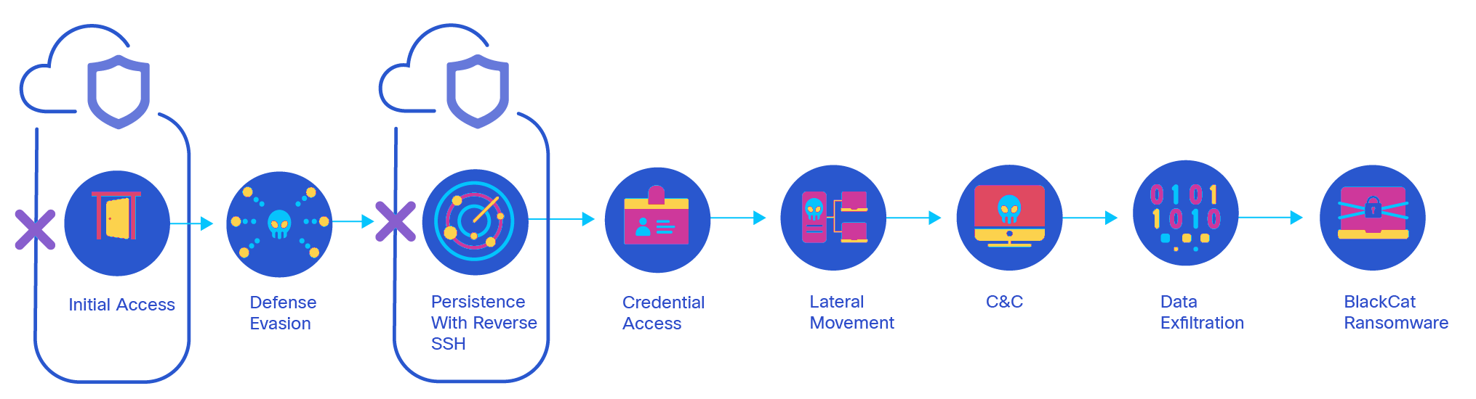
RANSOMWARE
BLACKCAT / ALPHV / NOBERUS
Notes:
Talk about ransomware chain.
Source image: https://umbrella.cisco.com/blog/cybersecurity-threat-spotlight-blackcat-ransomware-zingostealer-bumblebee-loader

Slide 5
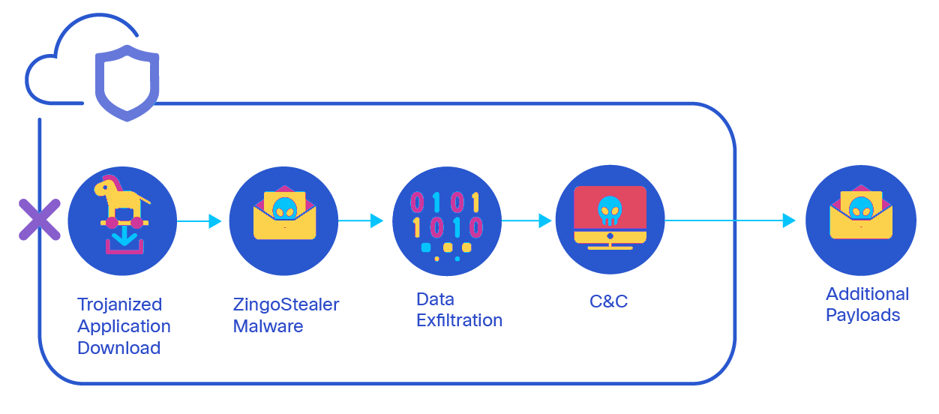
INFORMATION STEALERS
ZINGOSTEALER
Notes:
Talk about ransomware chain.
Source image: https://umbrella.cisco.com/blog/cybersecurity-threat-spotlight-blackcat-ransomware-zingostealer-bumblebee-loader

Slide 6
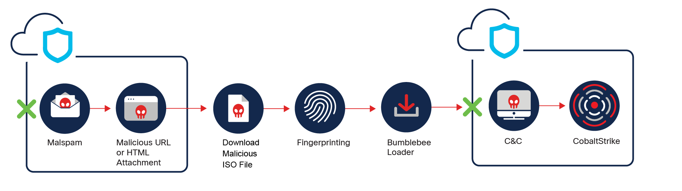
LOADERS
BUMBLEBEE
Notes:
Don't have access to latest malware but the previous versions are posted on Github.

Slide 7

INITIAL ACCESS & LOADER
DEEP DIVES
Rubeus
FUD-Loader
Rubeus is a C# toolset for raw Kerberos interaction and abuses.
Malware tool designed to deliver and execute malware on a system while evading detection by security software such as antivirus programs and intrusion detection systems.
Notes:
FUD=Fully Undetectable

Slide 8
INFOSTEALER & COMMAND/CONTROL (C2)
DEEP DIVES
SapphireStealer
Covenant
A simple stealer with sending logs to your EMAIL
Covenant is a .NET C2 framework that aims to highlight the attack surface of .NET, make the use of offensive .NET tradecraft easier, and serve as a collaborative platform for red teamers.

Slide 9

DEMO
https://github.com/GhostPack/Rubeus
RUBEUS
Rubeus can:
Gather information about domain trusts.
Forge a ticket-granting (golden) ticket.
Create silver tickets.
Kerberoast service tickets.
Rubeus can reveal the credentials of accounts that have Kerberos pre-authentication disabled.

Slide 10

DEMO
https://github.com/cobbr/Covenant
COVENANT
Covenant can:
• C2 Infrastructure: Establishes and manages command and control for penetration testing.
• Multi-Platform Support: Compatible with Windows, macOS, and Linux.
• Grunt Management: Executes and controls commands on compromised systems.
• Modular and Extensible: Supports custom modules and payloads.
• Secure Communication: Uses HTTPS and encryption for secure data transmission.
Notes:
Grunts are the same as agents or implants.

Slide 11

DEMO
https://github.com/0day2
FUD-LOADER & SAPHIRESTEALER
Fully Undetecatable Loader
Use of silent process execution
SaphireStealer
Steals browser creds, database, specific files
Exfiltrates using email or Telegram.

Slide 12
STEVEN H.
Ransomware Presentation
THANK YOU FOR ATTENTION
See You Next

